Slide 1

Jukebox Project
Guided By – Vaibhav Diwan

Slide 2
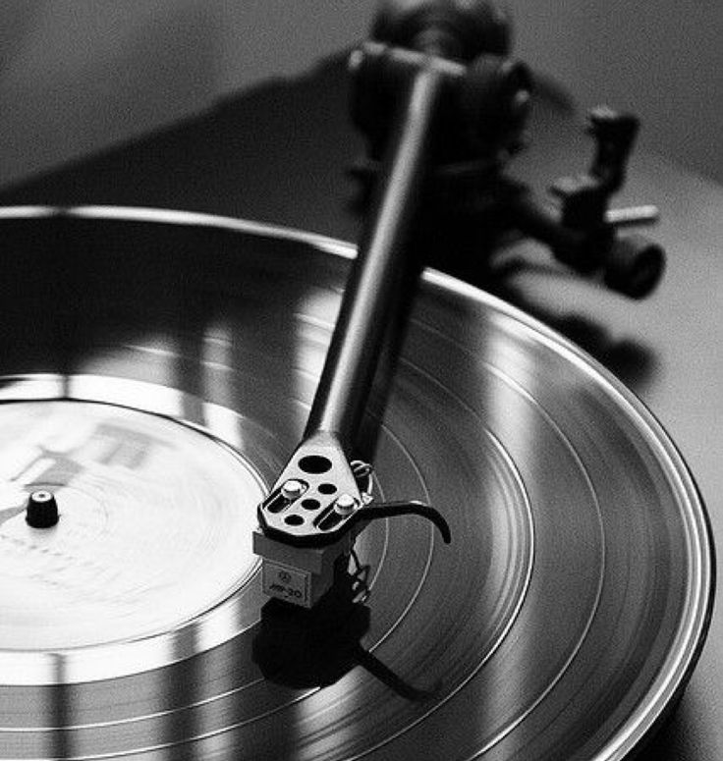
01
Introduction

Slide 3

What is a Jukebox
Jukebox is a music player.
It a machine that automatically plays a selected musical recording when a coin is inserted.

Slide 4





Features of Jukebox
Play/Pause the songs
Create
the playlist
Display
all the songs
Add Songs
to the playlist
Search
songs by name, genre, artist

Slide 5

02
Creating Database

Slide 6
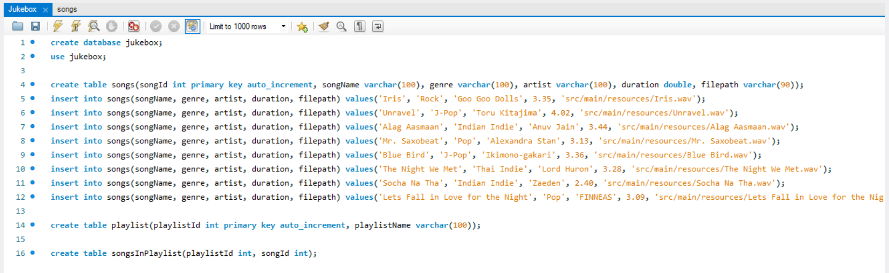
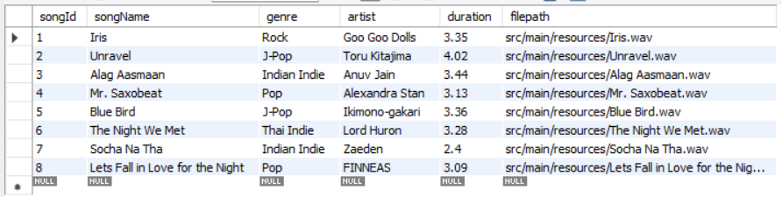
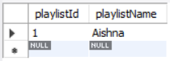
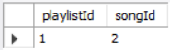

At first we’ve to create the database structure to begin the project. The following database structure have been followed in my project :
Created 3 Tables :
Songs
Playlist
Songs In Playlist

Slide 7

03
Project Structure

Slide 8
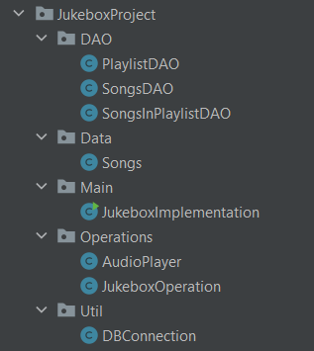
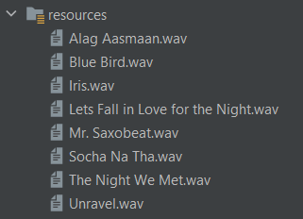
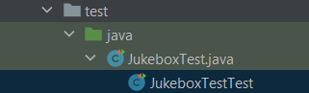
We’ve created a basic “Song” class for storing the data.
DAO classes contains JDBC logic .
We’ve store the songs in our resources folder, of which content root path has also been stored in the database.
For running the programme the important part in connecting with the database. For doing it we create a separate “DbConnection” Class.
For running the jukebox we need few methods & operations that are stored in the separate classes named, “JukeboxOperation” and “AudioPlayer”.
At last, in Implementation Class we’ve stored all our main methods, so the task properly run & jukebox working properly.
Creating test cases are important for the project so that we can identify if the project running properly or not.

Slide 9
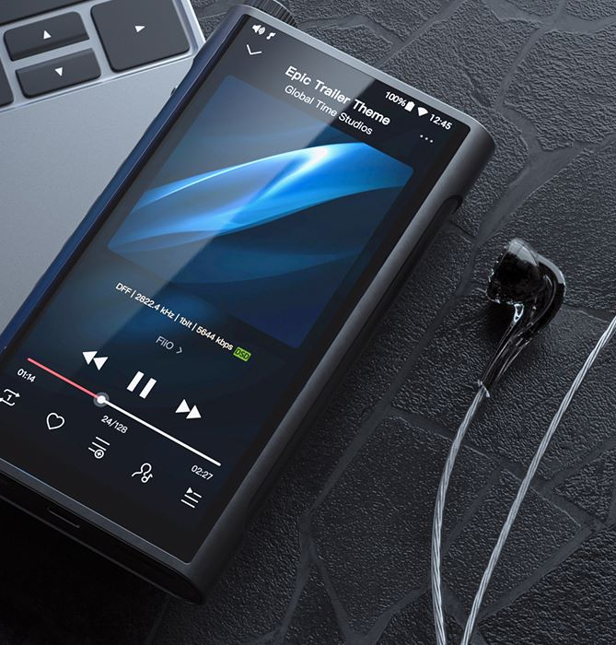
04
Output

Slide 10
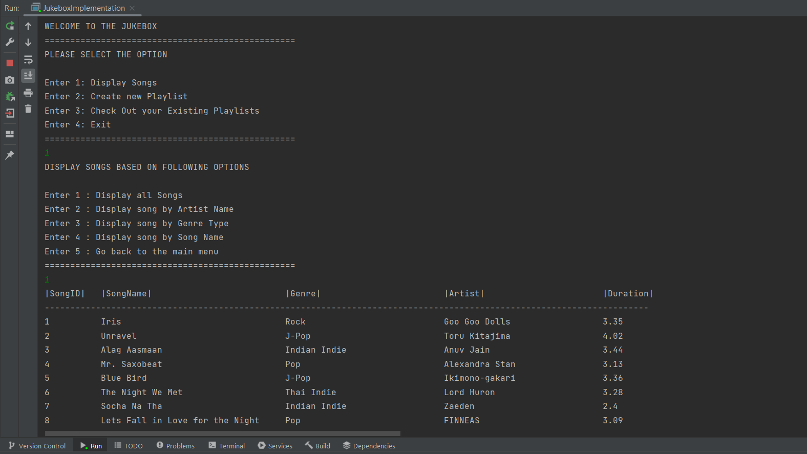
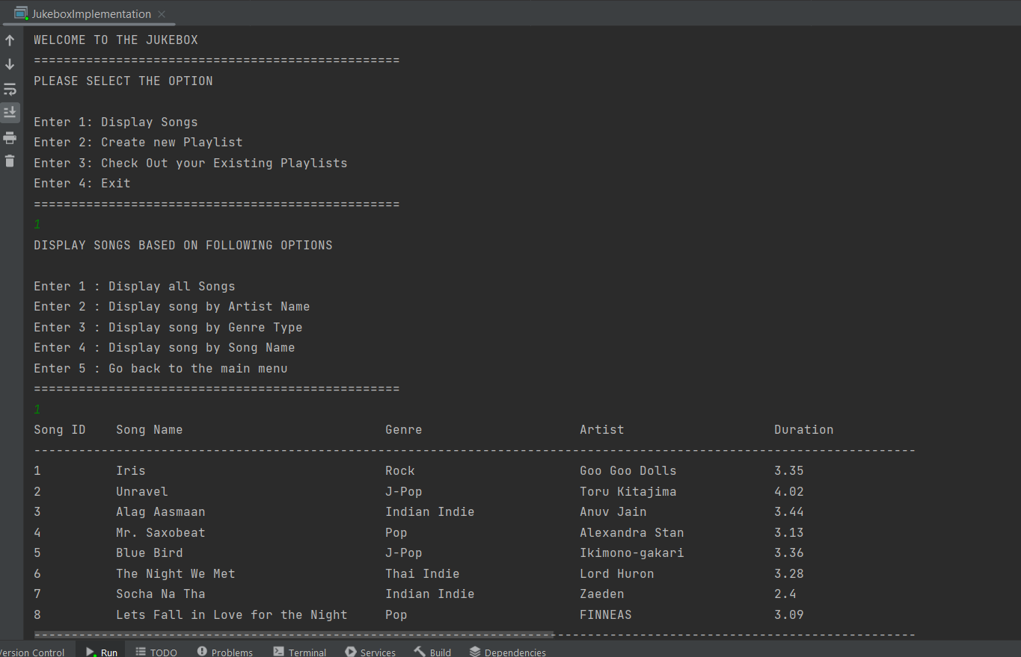

Slide 11
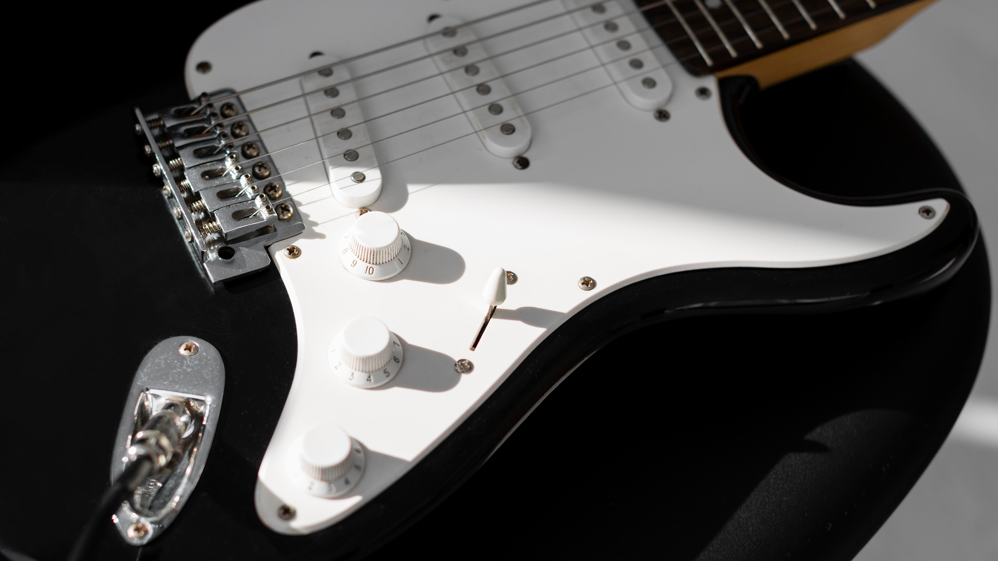
THANK YOU
Submitted By – Aishna Kushwah

